Slide 1


WEB TEAM PROJECT
team 10
장민호 오다은 구민영 양지훈
ENTER

Slide 2
CONTENT
PROJECT NAME
MOTIVATION
GOALS
RESULT
TEAM ROLES

Slide 3

PROJECT NAME
“KOREAN CULTURAL PROPERTIES”

Slide 4
MOTIVATION
“The idea that there are not many sites where foreigners can find Korean cultural properties led to the creation of this site.”

Slide 5
GOALS
“Our goal is to let foreigners and those who do not know Korean cultural properties know various cultural properties through this site.”

Slide 6
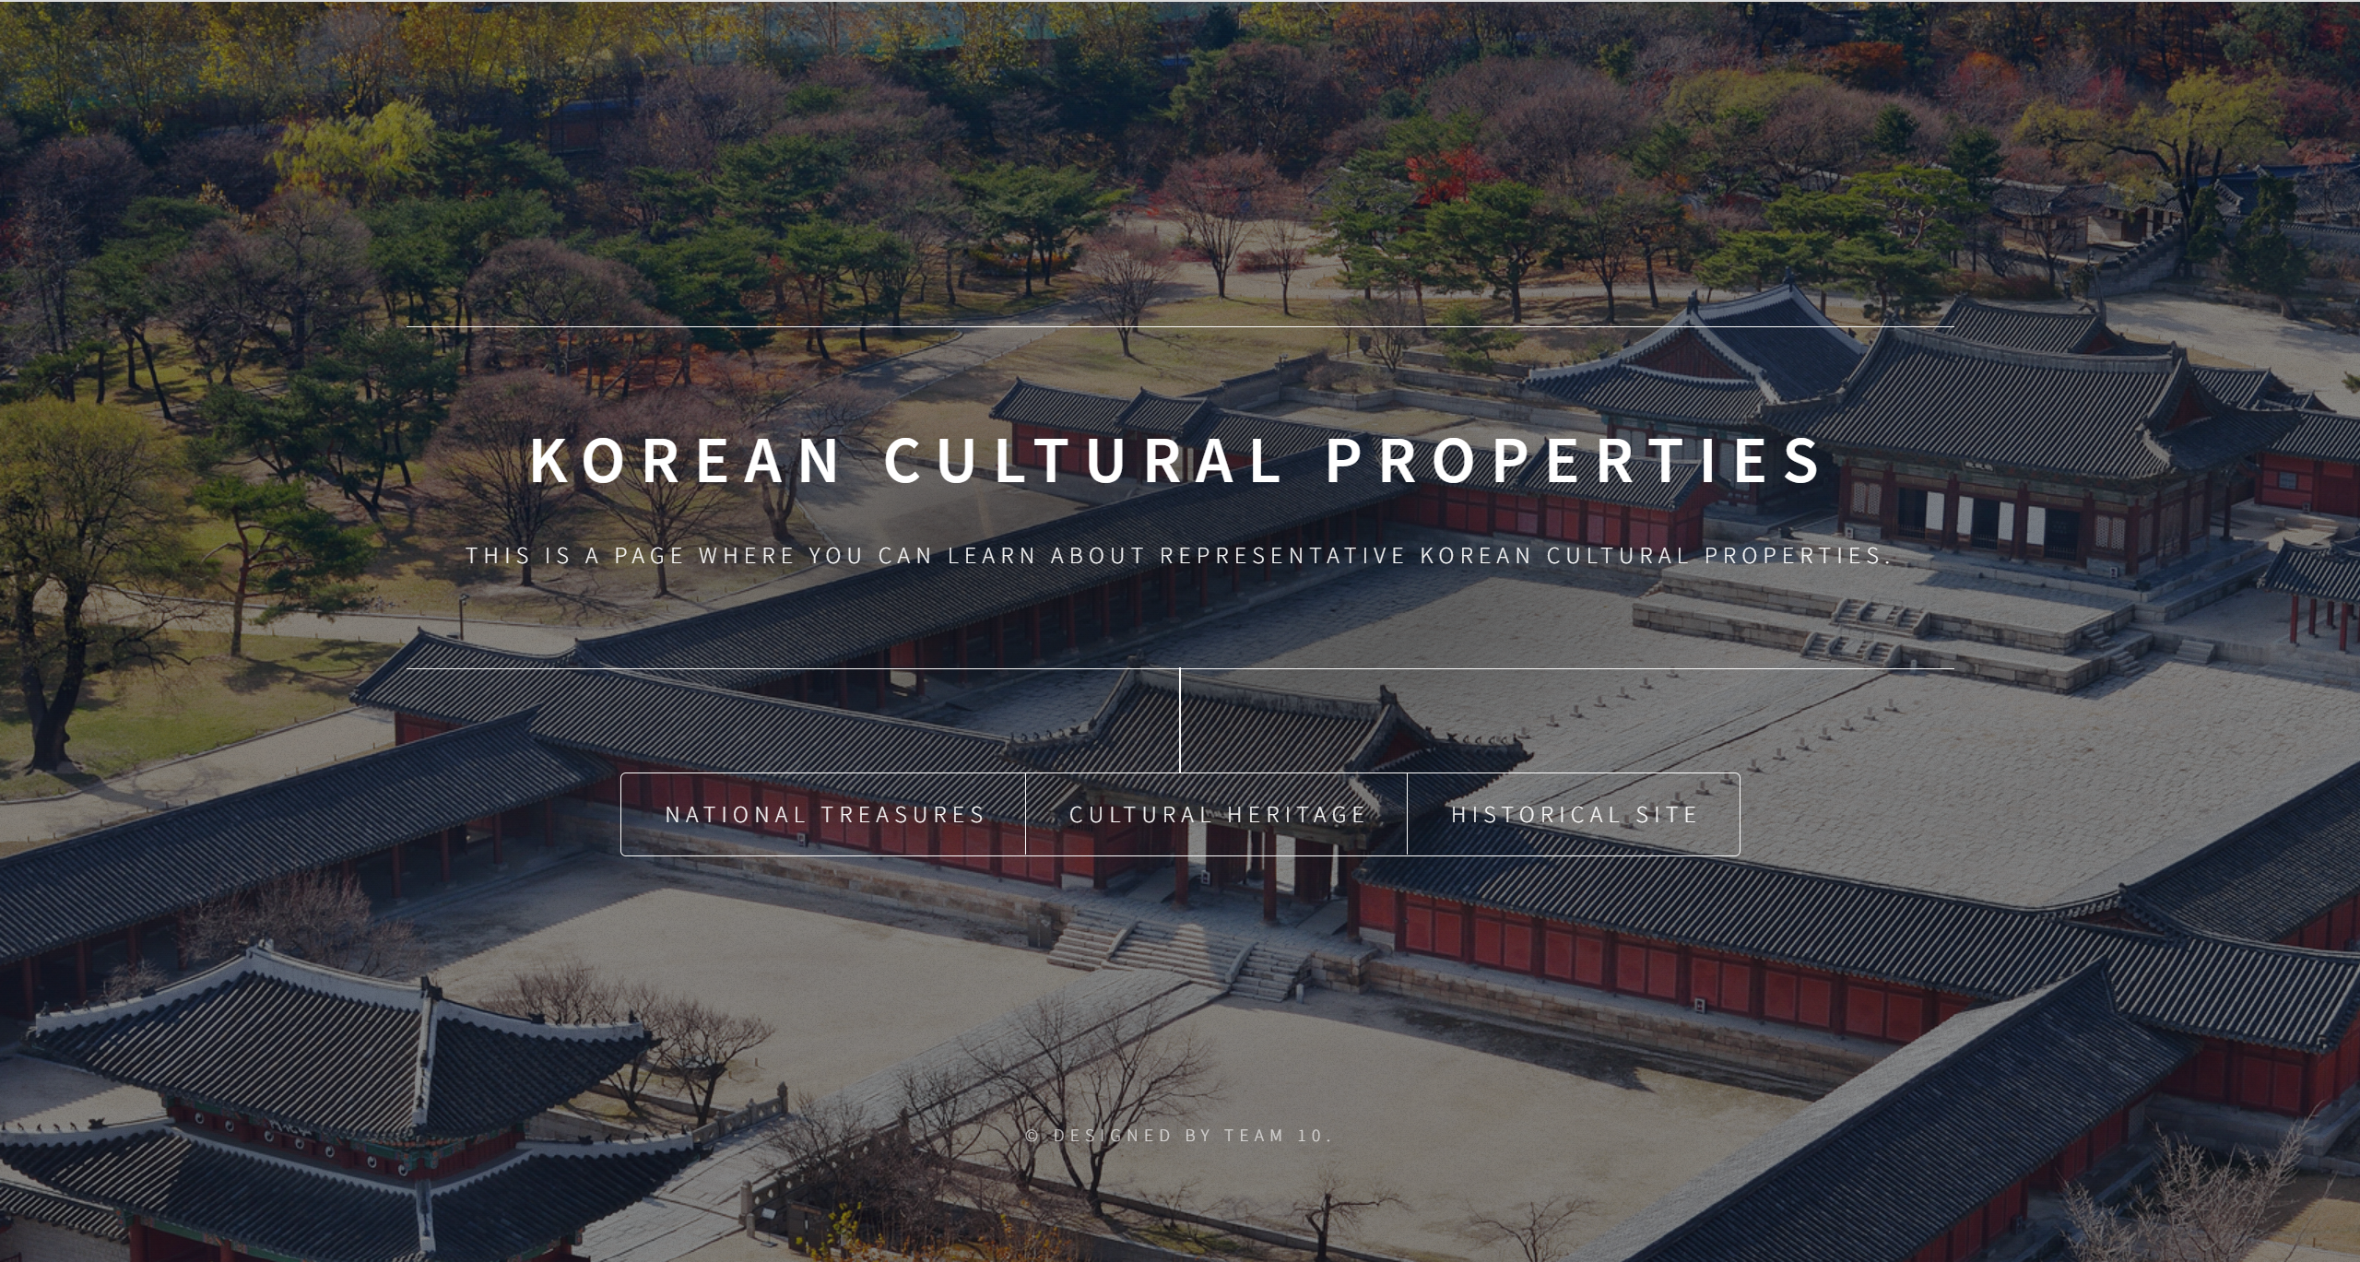
RESULT
1_MAIN PAGE
background image change every
few second
When click,
go to that page

Slide 7
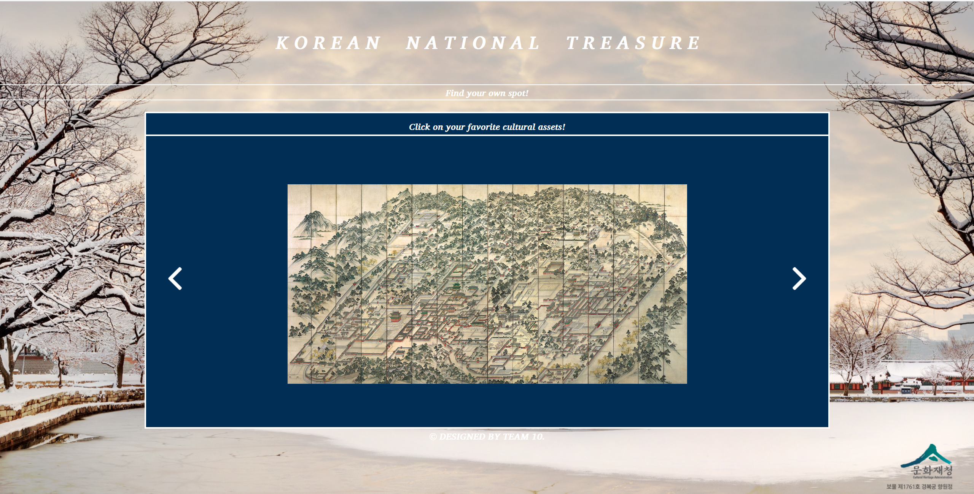
RESULT
2_NATIONAL TREASURES
When click, change
to the next image
When click, information about it open in new tab

Slide 8
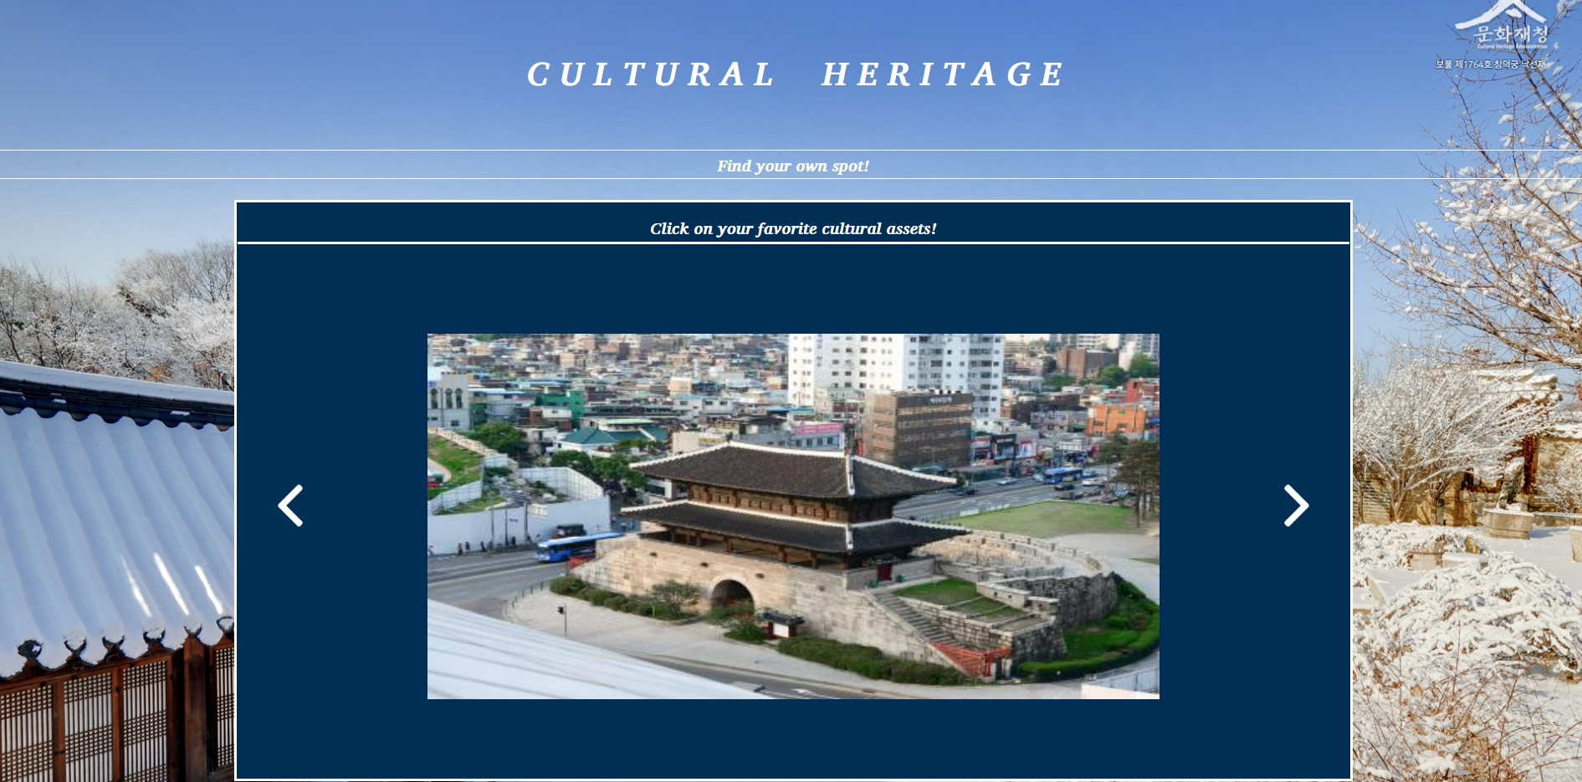
RESULT
3_CULTURAL HERITAGE
When click, change
to the next image
When click, information about it open in new tab

Slide 9
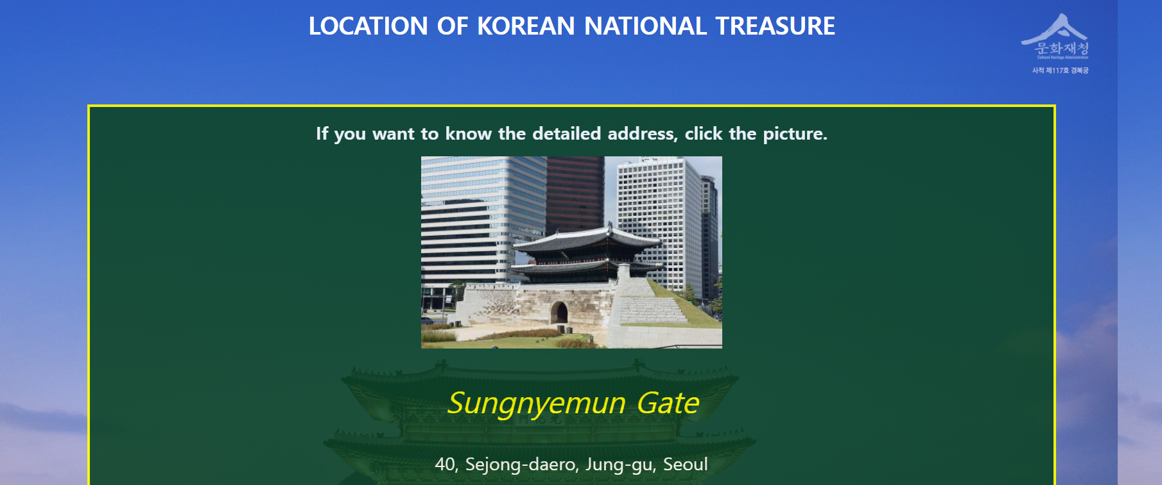
RESULT
4_HISTORICAL SITE
When click,
Google map about it
open in new tab

Slide 10
TEAM ROLES(coding part)
- 장민호 : 1p(main page)
- 오다은 : 2p(national treasure)
- 구민영 : 3p(cultural heritage)
- 양지훈 : 4p(historical site)

Slide 11
THANK YOU!

